Slide 1

The Fourth Hour!
Welcome to…

Slide 2
Introduction
Welcome to the Fourth Hour!
Name
Professor
A fun fact about you

Slide 3
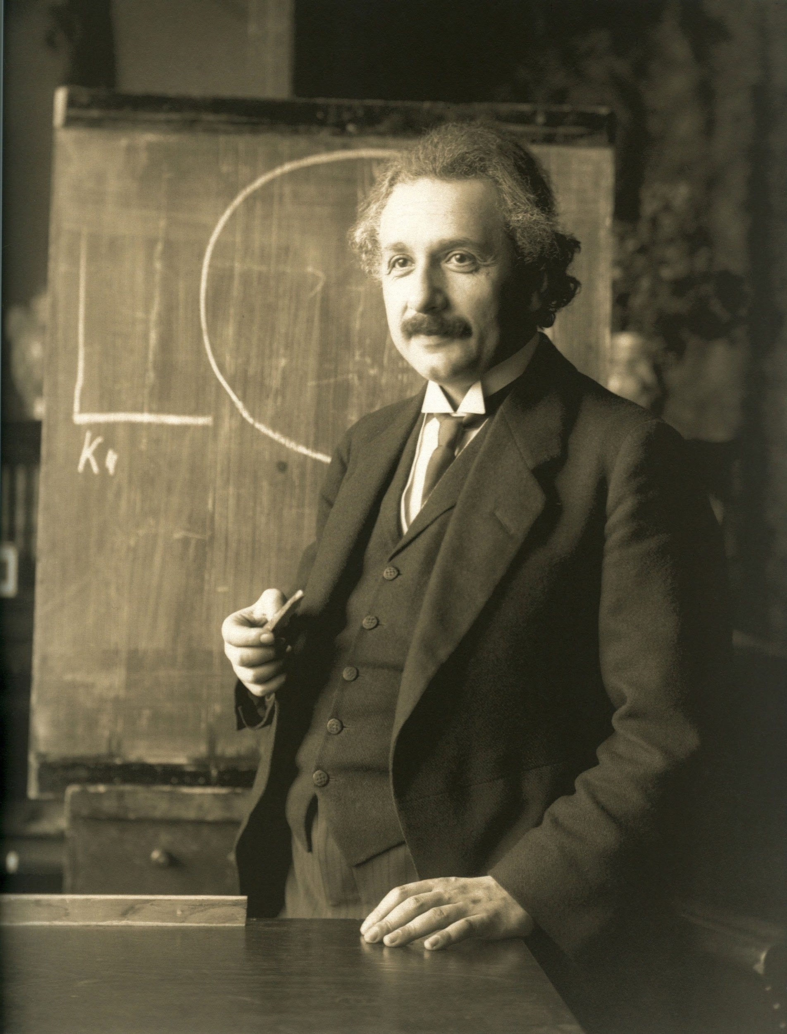
“Anyone who has never made a mistake has never tried anything new.”

Slide 4
Review
Login to Socrative at https://b.socrative.com/login/student/
Use code 4thHour149

Slide 5
Question 1
What is the value of x?
x = 1 / 2
0.5
0.0
0
1
Notes:
Make sure they do it alone then with a peer. EXPLAIN WHY WRONG IS WRONG (not just why right is right)

Slide 6
Question 1
What is the value of x?
x = 1 / 2
0.5
0.0
0
1

Slide 7
Answer the following…
2 + 3 → ?
3 * 4 + 2 → ?
3 * 4 + 2.0 → ?
5 / 10 → ?
2 ** 4 → ?

Slide 8
Answer the following…
2 + 3 → 5
3 * 4 + 2 → ?
3 * 4 + 2.0 → ?
5 / 10 → ?
2 ** 4 → ?

Slide 9
Answer the following…
2 + 3 → 5
3 * 4 + 2 → 14
3 * 4 + 2.0 → ?
5 / 10 → ?
2 ** 4 → ?

Slide 10
Answer the following…
2 + 3 → 5
3 * 4 + 2 → 14
3 * 4 + 2.0 → 14.0
5 / 10 → ?
2 ** 4 → ?

Slide 11
Answer the following…
2 + 3 → 5
3 * 4 + 2 → 14
3 * 4 + 2.0 → 14.0
5 / 10 → 0.5
2 ** 4 → ?

Slide 12
Answer the following…
2 + 3 → 5
3 * 4 + 2 → 14
3 * 4 + 2.0 → 14.0
5 / 10 → 0.5
2 ** 4 → 16

Slide 13
Question 2
What is the value of x?
x = 2.0 + 3 * 4
14
14.0
20
20.0

Slide 14
Question 2
What is the value of x?
x = 2.0 + 3 * 4
14
14.0
20
20.0

Slide 15
Order of Operations in CS
P
E
M D
A S
=
Notes:
In CS we use the acronym PEMDAS to remember the order of operations. But there is a catch we are going to for the purpose of this activity add an = sign at the end

Slide 16
Order of Operations in CS
Parenthesis ()
E
M D
A S
=
Notes:
In CS we use the acronym PEMDAS to remember the order of operations. But there is a catch we are going to for the purpose of this activity add an = sign at the end

Slide 17
Order of Operations in CS
Parenthesis ()
Exponents x ** 2
M D
A S
=
Notes:
In CS we use the acronym PEMDAS to remember the order of operations. But there is a catch we are going to for the purpose of this activity add an = sign at the end

Slide 18
Order of Operations in CS
Parenthesis ()
Exponents x ** 2
Multiplication * Division \
A S
=
Notes:
In CS we use the acronym PEMDAS to remember the order of operations. But there is a catch we are going to for the purpose of this activity add an = sign at the end

Slide 19
Order of Operations in CS
Parenthesis ()
Exponents x ** 2
Multiplication * Division \
Addition + Subtraction -
=
So what does the = stand for?
Notes:
In CS we use the acronym PEMDAS to remember the order of operations. But there is a catch we are going to for the purpose of this activity add an = sign at the end

Slide 20
Assignment
x = 5
Read as: x is assigned the value 5
Notes:
x = y is different than y = x (there must be a var on the left) ORDER MATTERS

Slide 21
Assignment
x = 5
Read as: x is assigned the value 5
Notes:
x = y is different than y = x (there must be a var on the left) ORDER MATTERS

Slide 22
Question 3 →PI
What is the value of a and b?
a = 1
b = 2
b = a
a: 1, b: 1
a: 1, b: 2
a: 2, b: 1
a: 2, b: 2

Slide 23
Question 3 →PI
What is the value of a and b?
a = 1
b = 2
b = a
a: 1, b: 1
a: 1, b: 2
a: 2, b: 1
a: 2, b: 2

Slide 24
What is the difference between / and //
At this point you understand what / does. For example:
9 / 4 → 2.25
10 / 4 → ?
Notes:
→ means “evaluates to”

Slide 25
What is the difference between / and //
At this point you understand what / does. For example:
9 / 4 → 2.25
10 / 4 → 2.5

Slide 26
What is the difference between / and //
At this point you understand what / does. For example:
9 / 4 → 2.25
10 / 4 → 2.5
But what if you don’t want all that nonsense after the decimal??
We use //
9 // 4 → 2
10 // 4 → ?

Slide 27
What is the difference between / and //
At this point you understand what / does. For example:
9 / 4 → 2.25
10 / 4 → 2.5
But what if you don’t want all that nonsense after the decimal??
We use //
9 // 4 → 2
10 // 4 → 2

Slide 28
Question 4 → PI
What is the value of x?
x = 5 + (2**2) // 4 - 1
5
3.25
6
1.25

Slide 29
Question 4 → PI
What is the value of x?
x = 5 + (2**2) // 4 - 1
5
3.25
6
1.25

Slide 30
Discussion About Mod
Mod is often used to find the REMAINDER
For example, when evaluating the arithmetic expression 17 / 3 the result is

Slide 31
Discussion About Mod
Mod is often used to find the REMAINDER
For example, when evaluating the arithmetic expression 17 / 3 the result is
5.666667

Slide 32
Discussion About Mod
Mod is often used to find the REMAINDER
For example, when evaluating the arithmetic expression 17 / 3 the result is
5.666667
But what happens to the remainder value?

Slide 33
Discussion About Mod
Mod is often used to find the REMAINDER
For example, when evaluating the arithmetic expression 17 / 3 the result is
5.666667
But what happens to the remainder value?
We can use mod to get the remainder of the arithmetic expression above
What is the result of 17 % 3

Slide 34
Discussion About Mod
Mod is often used to find the REMAINDER
For example, when evaluating the arithmetic expression 17 / 3 the result is
5.666667
But what happens to the remainder value?
We can use mod to get the remainder of the arithmetic expression above
What is the result of 17 % 3
2
Notes:
Do a division problem on the board
ex. 17 / 3
17 // 3
17 % 3

Slide 35
Question 5
What is the value of x?
x = 3 * (2 % 5)
2
6
1
1.2

Slide 36
Question 5
What is the value of x?
x = 3 * (2 % 5)
2
6
1
1.2

Slide 37
Answer the following…
Work in pairs to solve the following:
18 % 5 → ?
(9 * 10) % 5 → ?
(8 / 4) % 5 → ?

Slide 38
Answer the following…
Work in pairs to solve the following:
18 % 5 → 3
(9 * 10) % 5 → ?
(8 / 4) % 5 → ?

Slide 39
Answer the following…
Work in pairs to solve the following:
18 % 5 → 3
(9 * 10) % 5 → 0
(8 / 4) % 5 → ?

Slide 40
Answer the following…
Work in pairs to solve the following:
18 % 5 → 3
(9 * 10) % 5 → 0
(8 / 4) % 5 → 2.0

Slide 41
Some Shorthand…
Recall that:
a = 0
a = a + 1
print(a)
results in 1 being printed.
Can we simplify this?

Slide 42
Some Shorthand…
Can we simplify this?
YES!
a = 0
a += 1
print(a)
Also results in 1 being printed.

Slide 43
Some Shorthand…
We can do this with other operations such as -=, *=, and /=
For example:
a = 2
a *= 5
print(a)
results in 10 being printed.

Slide 44
Question 6
What is the value of x?
x = 2
x *= 3
x += 2
6
2
8
ERROR

Slide 45
Question 6
What is the value of x?
x = 2
x *= 3 #6
x += 2 #8
6
2
8
ERROR

Slide 46
Printing
If we want to do a simple print statement we can do:
print(“Hello world!”)
Hello world!
But what if we want to print two Strings what would we do?

Slide 47
Printing
If we want to do a simple print statement we can do:
print(“Hello world!”)
Hello world!
But what if we want to print two Strings what would we do?
print(“Hello”, “world!”)
Hello world!

Slide 48
Printing
What if we want to print a String and a variable?
a = “Hello”

Slide 49
Printing
What if we want to print a String and a variable?
a = “Hello”
print(a + “ world!”)
Hello world!
or
print(a, “world!”)
Hello world!
Note that the , adds a space while the + does not.

Slide 50
Question 7
True or False: Do the following statements print out the same thing?
print(“CS“, 149, “is my favorite!”)
print(“CS“, (1 + 4 + 9), “is my favorite!”)
True
False

Slide 51
Question 7
True or False: Do the following statements print out the same thing?
print(“CS“, 149, “is my favorite!”)
CS 149 is my favorite!
print(“CS“, (1 + 4 + 9), “is my favorite!”)
True
False

Slide 52
Question 7
True or False: Do the following statements print out the same thing?
print(“CS“, 149, “is my favorite!”)
CS 149 is my favorite!
print(“CS“, (1 + 4 + 9), “is my favorite!”)
CS 14 is my favorite!
True
False

Slide 53
Review

Slide 54
Review 1 → PI
What is the value of x and y?
x = 2
y = 3
x = y
x: 2, y: 2
x: 3, y: 2
x: 2, y: 3
x: 3, y: 3

Slide 55
Review 1 → PI
What is the value of x and y?
x = 2
y = 3
x = y
x: 2, y: 2
x: 3, y: 2
x: 2, y: 3
x: 3, y: 3

Slide 56
Review 2 → PI
What is the value of x?
x = 9 - 6 / 4 * (1 + 2)
8.5
4.5
3.5
6.5

Slide 57
Review 2 → PI
What is the value of x?
x = 9 - 6 / 4 * (1 + 2)
8.5
4.5
3.5
6.5
Notes:
9 - 1.5 * 3

Slide 58

Questions?

